Slide 1

Topics Covered: List, Range, Tuples, Dictionaries, Set
Semester: 3rd Paper code: AIML203 Subject: Foundations of Data Science

Slide 2
Prerequisite of the topic:
variables, Numbers, string, type conversion etc..
Objectives of the topic:
To differentiate among the different built-in data types in python.
To understand and be able to implement it in real life situations.
Outcome of the topic:
To familiarise students with built-in data types available in python so that students should apply appropriate data structure for given problem.

Slide 3
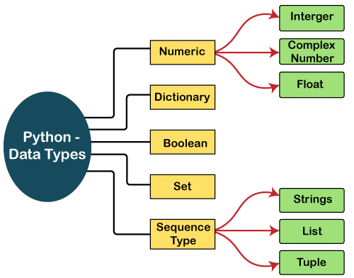
Python Built-in Data types:

Slide 4
List
A list is a sequential collection of values, it is a data structure.
Each value has a location (an index):
Indexes range from 0 to n-1(where n is the length of the list)and from -1 to -n
Lists are:
heterogeneous i.e.,values can be of any type (strings are homogeneous because their elements are characters)
Ordered changeable, and allow duplicate values.
Ways to create a list:
Hard code the values mylist = [3, 9, ‘a’, 7.2]
Using the replication operator: mylist = [0] * 100 (gives a list with 100 zeros)

Slide 5
Use the split method on a string
Use the readlines method on a file.
list method
Operators in list:
Slice operator: for accessing item from the list, symbol: []
Replication operator: for concatenating multiple copies of the same string, symbol:*
Concatenation operator: used to join the strings, symbol: +
Range slice operator: used to access the characters from the specified range, symbol: [:]
in: Membership operator: returns if a particular sub-string is present in the specified string.

Slide 6
Example
1. Creating list
thislist = ["apple", "banana", "cherry"]
print(thislist) ---- [‘apple’, ‘banana’, ‘cherry’]
2. Duplicate Values
thislist = ["apple", "banana", "cherry", "apple", "cherry"] print(thislist) --- [‘apple’, ’banana’, ’cherry’, ’apple’, ’cherry’]
3.Print the second item of the list
thislist = ["apple", "banana", "cherry"] print(thislist[1]) ----banana
4. List extend() Method- The extend() method adds the specified list elements (or any iterable) to the end of the current list.
fruits = ['apple', 'banana', 'cherry'] cars = ['Ford', 'BMW', 'Volvo'] fruits.extend(cars) ---- ['apple', 'banana', 'cherry', 'Ford', 'BMW', 'Volvo']

Slide 7
List Methods
pop():Removes the element at the specified position
remove():Removes the item with the specified value
reverse():Reverses the order of the list
sort():Sorts the list
index():Returns the index of the first element with the specified value
insert():Adds an element at the specified position
append(), clear(), copy(), count(), extend()

Slide 8
Example
['apple', 'banana', 'watermelon', 'cherry']
Change Item Value
thislist = ["apple", "banana", "cherry"] thislist[1] = "blackcurrant" print(thislist) ---- ['apple', 'blackcurrant', 'cherry’]
Insert Items
thislist = ["apple", "banana", "cherry"] thislist.insert(2, "watermelon") print(thislist)---- ['apple', 'banana', 'watermelon', 'cherry’]
Append Items
thislist = ["apple", "banana", "cherry"] thislist.append("orange") print(thislist) ---- [['apple', 'banana', 'cherry’, ‘orange’]
The count() method returns the number of elements with the specified value.
fruits = ["apple", "banana", "cherry"]
x = fruits.count("cherry")
print(x) ---- 1

Slide 9
Example
Remove() item
thislist = ["apple", "banana", "cherry"] thislist.remove("banana") print(thislist) ---- [‘apple’,’cherry’]
Remove Specified Index– pop()
thislist = ["apple", "banana", "cherry"] thislist.pop(1) print(thislist) ---['apple', 'cherry’]
The del keyword also removes the specified index-can remove entire list
thislist = ["apple", "banana", "cherry"] del thislist[0] print(thislist)------['banana', 'cherry']

Slide 10
Example
The clear() method empties the list but list still remains
thislist = ["apple", "banana", "cherry"] thislist.clear() print(thislist)----[]
Sort List Alphanumerically-sort()
thislist = ["orange", "mango", "kiwi", "pineapple", "banana"]
thislist.sort()
print(thislist) ---['banana', 'kiwi', 'mango', 'orange', 'pineapple’]
Sort Descending
thislist = ["orange", "mango", "kiwi", "pineapple", "banana"]
thislist.sort(reverse = True)
print(thislist)---['pineapple', 'orange', 'mango', 'kiwi', 'banana']

Slide 11
Range
The range() function returns a sequence of numbers, starting from 0 by default, and increments by 1 (by default), and stops before a specified number.
Syntax: range(start, stop, step)
start: Optional. An integer number specifying at which position to start. Default is 0
stop: Required. An integer number specifying at which position to stop.
step: Optional. An integer number specifying the incrementation. Default is 1

Slide 12
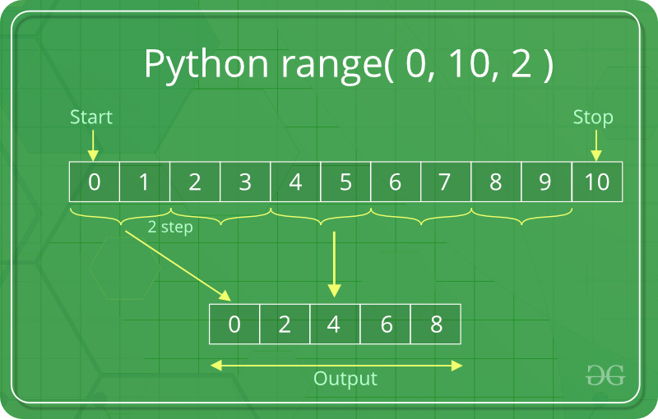
Range
Example:
for i in range(0, 30, 3):
print(i, end=" ")
print()
# using range to print number divisible by 5
for i in range(0, 50, 5):
print(i, end=" ")
Output :
0 3 6 9 12 15 18 21 24 27
0 5 10 15 20 25 30 35 40 45

Slide 13
Tuple
Tuples are used to store multiple items in a single variable.
Tuple is one of 4 built-in data types in Python used to store collection of data.
Tuples are written with round brackets.
Tuple items are ordered, unchangeable, and allow duplicate values.
Tuple items are indexed, the first item has index [0], the second item has index [1] etc.
Ways to create a Tuple:
thistuple = ("apple", "banana", "cherry")
thistuple = "apple", "banana", "cherry"
thistuple = “apple”,

Slide 14
Tuple
Deleting Tuple:
Unlike lists, the tuple items cannot be deleted by using the del keyword as tuples are immutable. To delete an entire tuple, we can use the del keyword with the tuple name.
Update Tuple:
You can convert the tuple into a list, change the list, and convert the list back into a tuple.
x = ("apple", "banana", "cherry")
y = list(x)
y[1] = "kiwi"
x = tuple(y)
print(x)

Slide 15
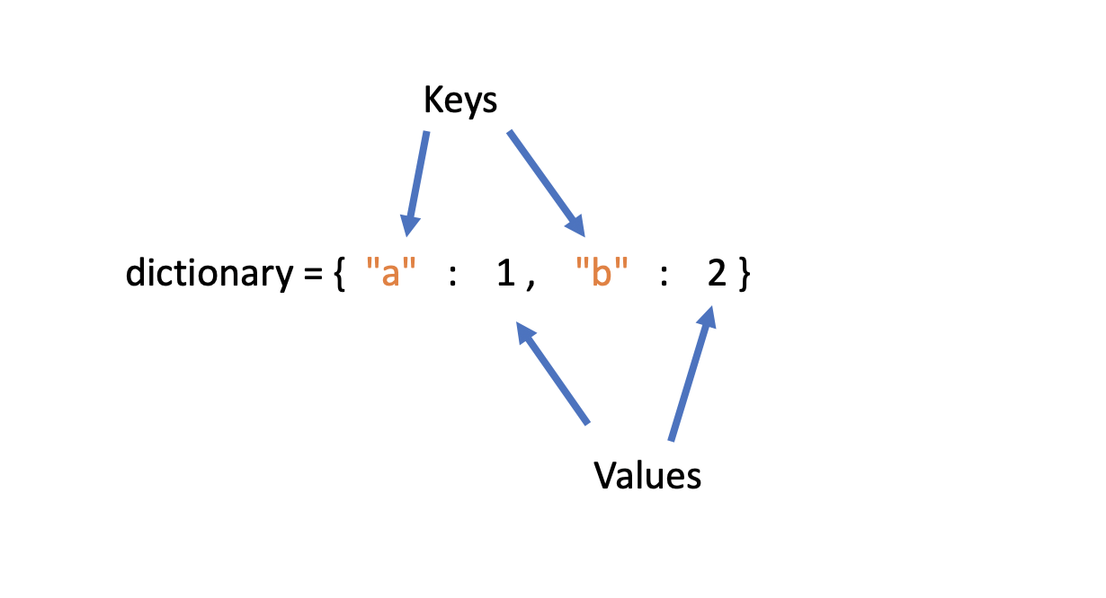
Dictionaries
Dictionaries are the built-in data types in python that stores the values in key-value pair.
A dictionary is a collection which is ordered*, changeable and do not allow duplicates.
Dictionary keys must be unique: A key in a dictionary is like an index in list.
Keys can be of any data types as long as it is immutable.
There are three main ways to create a dictionary in Python:
Construct a python dictionary (using the curly braces)
Construct a dictionary from a list of key, value pairs
Construct a dictionary from two lists
Example: dict5 = {('a' : 'apple')}

Slide 16
Dictionaries
Empty Dictionary: Create and empty dictionary by using {}
Access: The values can be accessed in the dictionary by using the keys as keys are unique in the dictionary.
Add: dictionary is a mutable data type, and its values can be updated by using the specific keys. Dict[key] = value.
Update: The update() method is also used to update an existing value.
Delete: The items of the dictionary can be deleted by using the del keyword del dictionary_name [key]]

Slide 17
Set
Sets are used to store multiple items in a single variable.
A set is a collection which is unordered, unchangeable*, and unindexed.
Sets cannot have two items with the same value.
create a set: thisset = {"apple", "banana", "cherry"}
print(thisset)
You cannot access items in a set by referring to an index or a key.
But you can loop through the set items using a for loop, or ask if a specified value is present in a set, by using the in keyword.

Slide 18
Set
Add item: To add one item to a set use the add() method.
Remove item: remove an item in a set, use the remove(), or the discard() method.
Join set: There are several ways to join two or more sets in Python.
use the union() method that returns a new set containing all items from both sets
update() method that inserts all the items from one set into another:

Slide 19
Questions asked by companies:-
What are the benefits of using Python language as a tool in the present scenario?
Which sorting technique is used by sort() and sorted() functions of python?
Is Python a compiled language or an interpreted language?
How are arguments passed by value or by reference in Python?
Is Tuple Comprehension? If yes, how and if not why?
How to check if a key exists in a dictionary?
Does converting an object to a set maintain the object’s order?
What is difference between / and // in Python?

Slide 20
Worksheet Questions
​​https://www.hackerrank.com/challenges/python-lists/problem
https://www.hackerrank.com/challenges/python-tuples/problem
https://www.hackerrank.com/challenges/30-dictionaries-and-maps/problem
https://www.hackerrank.com/challenges/py-introduction-to-sets/problem
https://www.hackerrank.com/challenges/no-idea/problem
https://leetcode.com/problems/implement-magic-dictionary/
https://leetcode.com/problems/longest-mountain-in-array/
https://leetcode.com/problems/median-of-two-sorted-arrays/
https://leetcode.com/problems/third-maximum-number/
https://leetcode.com/problems/3sum/
https://www.codechef.com/problems/SLICE_PY
https://www.codechef.com/problems/LISTLIST
https://www.codechef.com/problems/ENCJMAY3
https://www.codechef.com/problems/LOSTNUM
https://www.codechef.com/problems/TNP504

